Slide 1
Cartography task challenges and pitfalls
Obtaining information from
aerospace photographs
by Dzmitry Paulenka, dmitri.pavlenko@gmail.com,
link to presentation’s last version

Slide 2
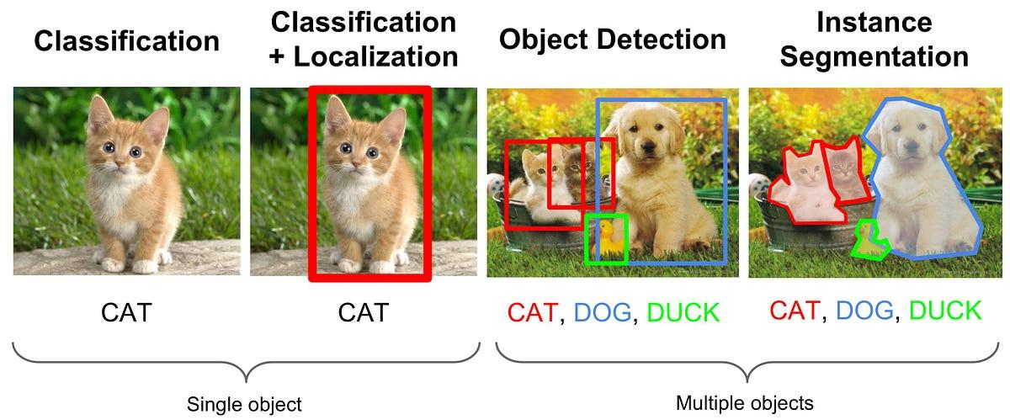
Challenge 1. Different tasks in computer vision
Three core tasks in computer vision with increasing levels of complexity.

Slide 3
Challenge 2. Distinct paradigms within machine learning
Supervised Learning
Unsupervised Learning
Semi-Supervised Learning

Slide 4
Challenge 3. Where to get data (labeled and / or unlabeled)?
Find a ready-made data set.
Google Datasearch engine: https://datasetsearch.research.google.com/
Kaggle: https://www.kaggle.com/
DataHub: https://datahub.com/
NASA Datasets: https://data.nasa.gov/
Top Cars Datasets: https://universe.roboflow.com/browse/transportation/cars

Slide 5
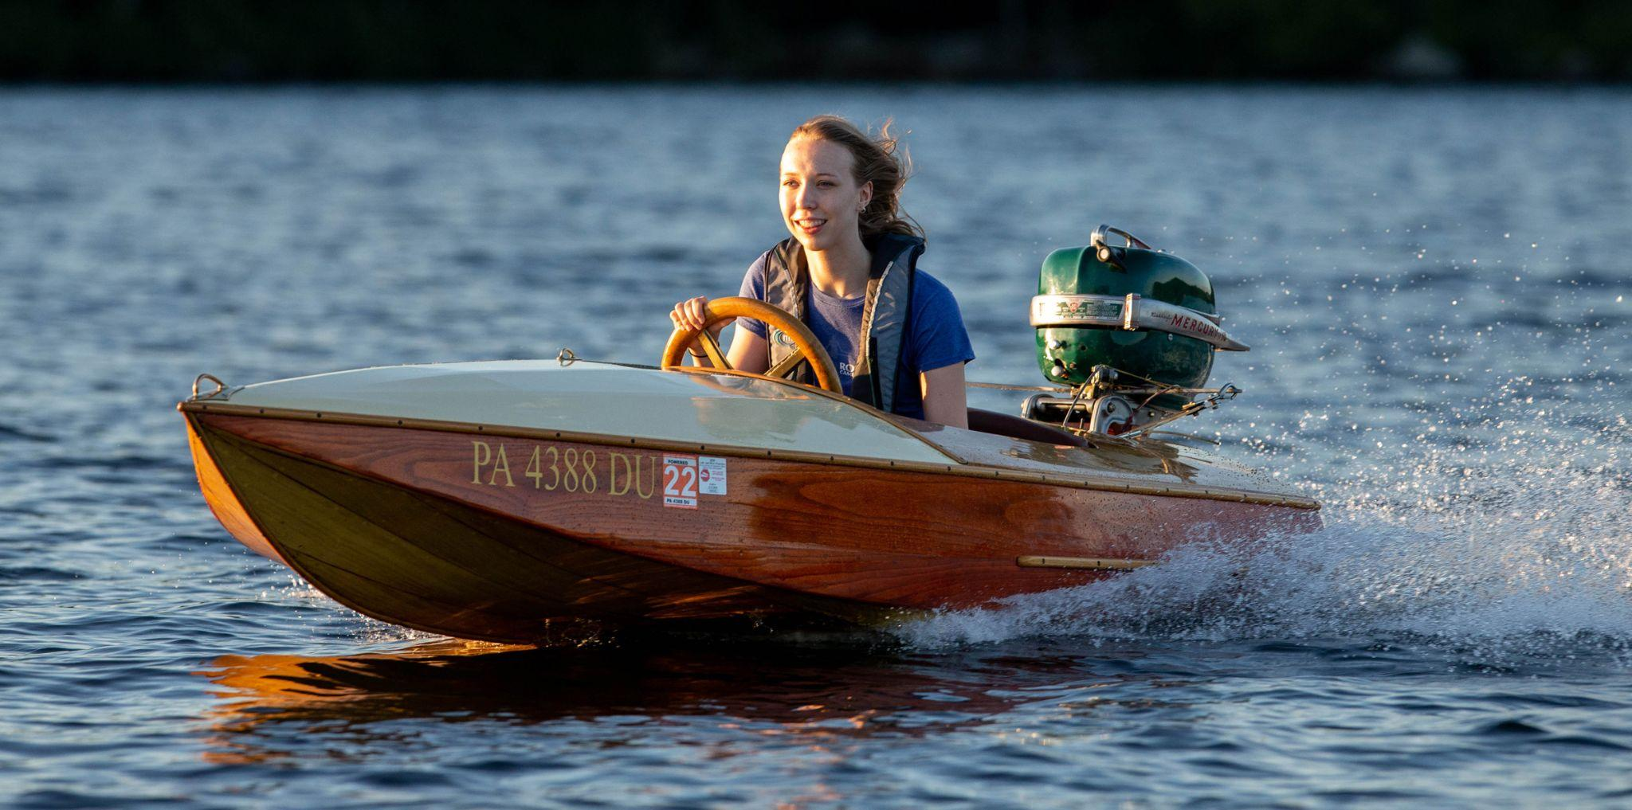
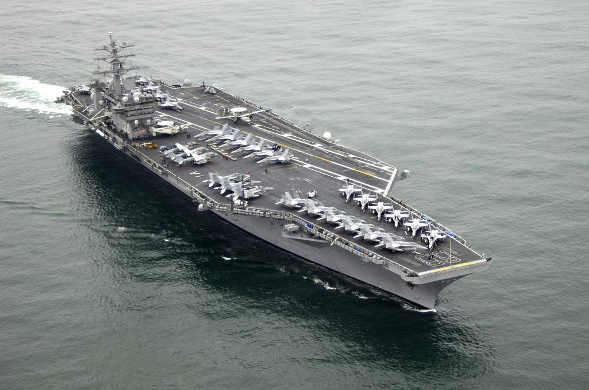
Challenge 4. Different object sizes
This is a boat.
And this is also a boat.

Slide 6
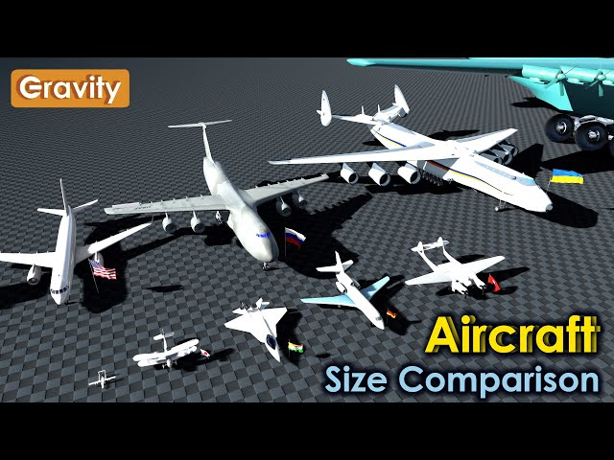

Slide 7
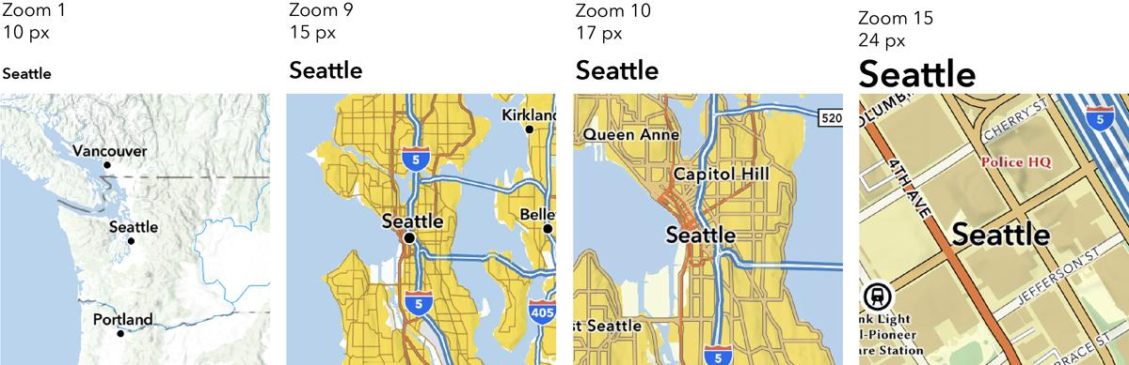
Challenge 5. The same objects at different scales

Slide 8
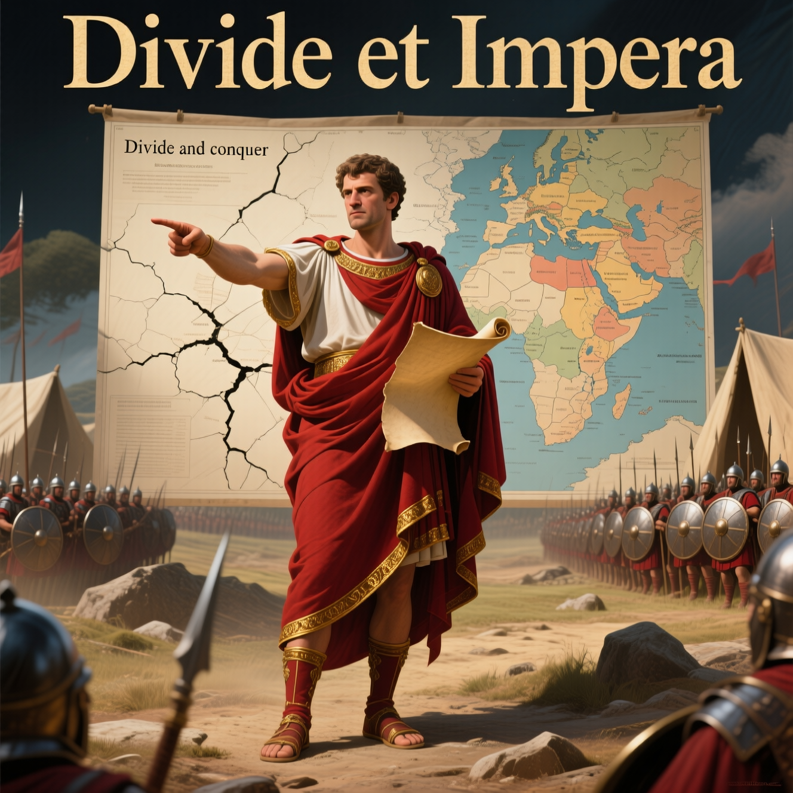
Divide-and-conquer method
A universal method for solving tasks.
Divide the main task into smaller tasks, and then divide them over and over again... until each subtask can be accomplished in a reasonable amount of time and with moderate efforts.

Slide 9
Divide the main task into smaller tasks
Obtain information from
aerospace photographs
Generate maps from aerospace photographs
Other tasks?
Object detection on aerospace photographs
Continue dividing further...

Slide 10
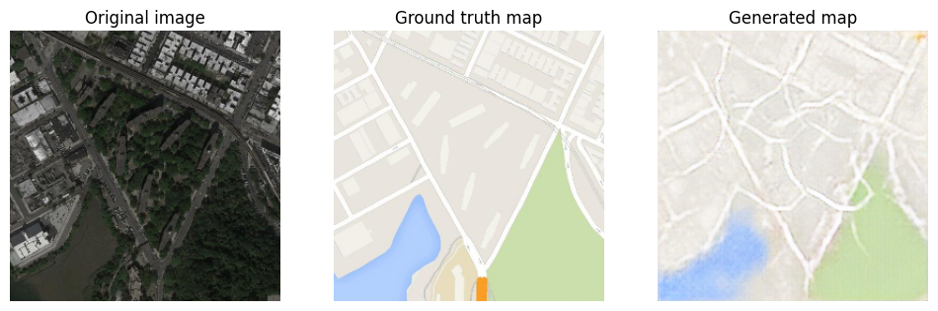
Task 1. Generate maps with image-to-image translation
My example of Pix2Pix GAN implementation in 2025.07.25_execises.
The result is not as good as I expected.

Slide 11
Task 2. Object detection using YOLO architecture
My example of YOLO version 1 implementation
in 2025.07.25_execises.
However, you should fine-tune pre-trained YOLO version 11 for better performance. Or use other advanced object detector architecture.

Slide 12
Task 3. Geospatial image location referencing
Geolocation: Where is your plane flying now?
No BeiDou Navigation Satellite System (BDS), no GPS, no WiFi…
My example of object detector based on feature extractor in 2025.07.25_execises.
See the next slide

Slide 13
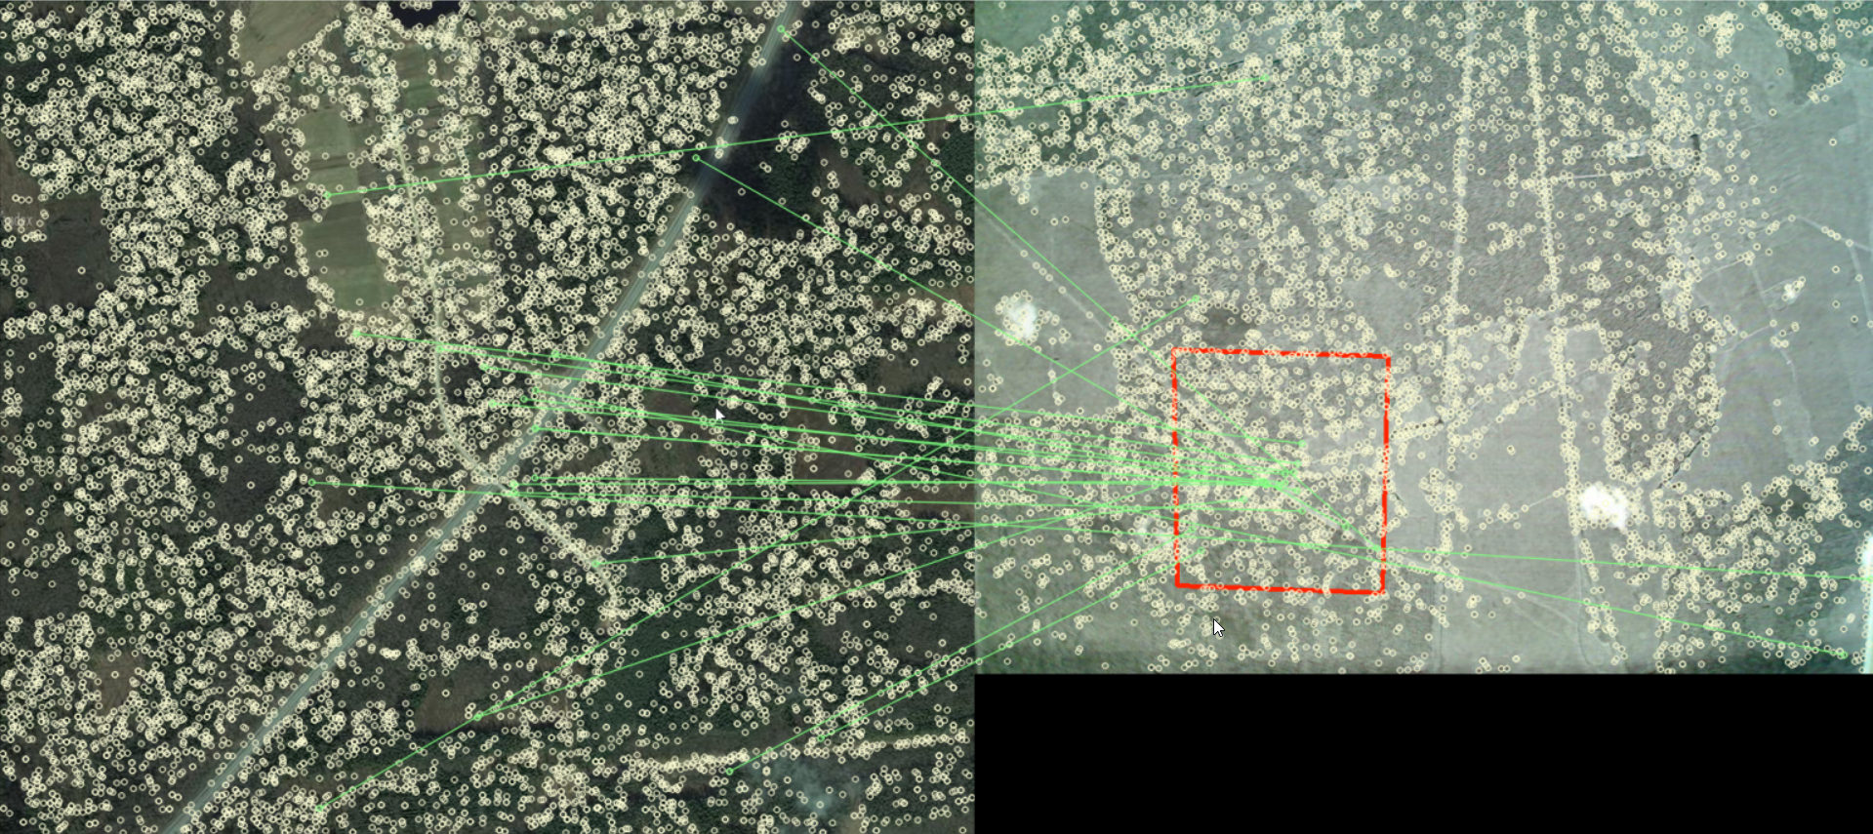
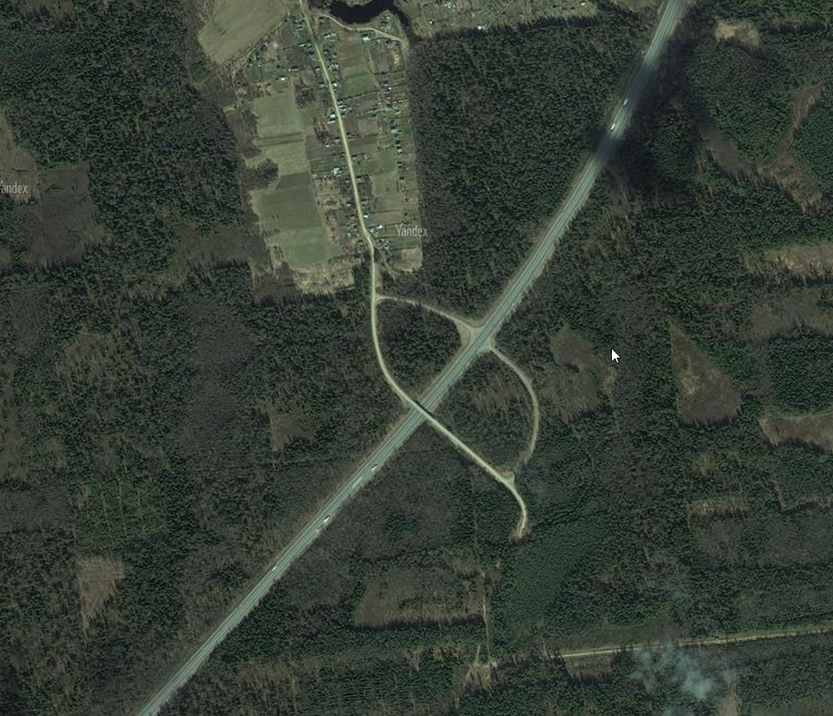
This photo was taken here.
Latitude = 123 and longitude = 456.

Slide 14
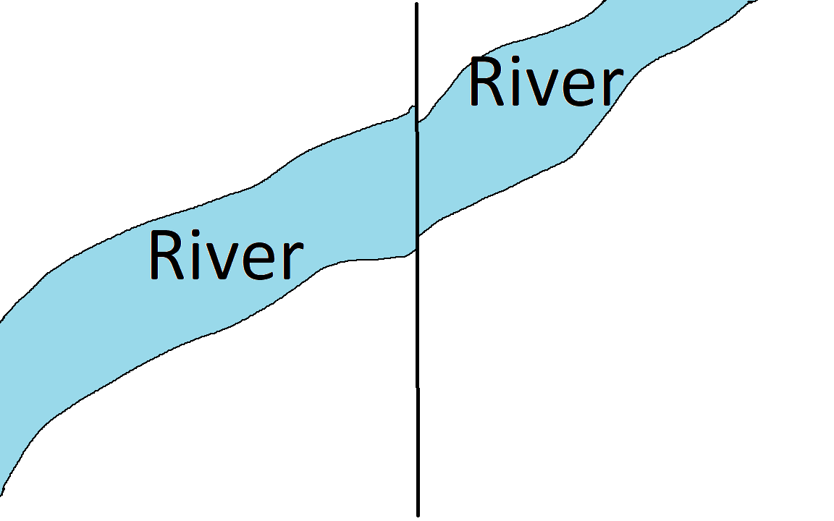
Task 4. Make a bigger image
How to seamlessly glue small fragments of a large aerial photograph?

Slide 15
Task 5, … Task N
Convert pixels (x,y) on an image to latitude and longitude on a map and vice versa latitude and longitude to pixels.
Good application should have object tracker.
Various engineering and management tasks: What is the short name of your project? What is the distribution license? Which operating system should you choose? Which Python version should you choose? Which libraries should you choose? Do you need to package the source code in a Docker container for deployment? Does your application need a graphical user interface (GUI)? Is this an online (web) or offline (standalone) application?
…, et cetera.

Slide 16
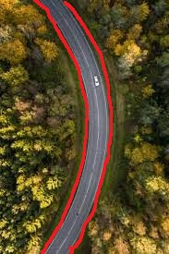
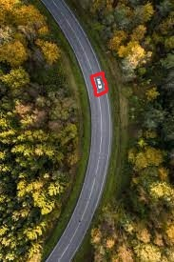
Task N+1. "Conquer" part of divide-and-conquer method
Combine all solved subtasks into one application.
Task 1. Generate map
Result: "This is a road".
Task 2. Object detection
Result: "This is a car"
Task 3. Geolocation
Result: "Latitude = 123 and longitude = 456".
+
+
=

Slide 17
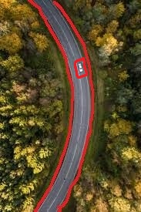
Final result: "This is a car on the road. Latitude = 123 and longitude = 456".
=

Slide 18
Discussion
Most likely you’ll have:
Separate machine learning paradigms for maps (image-to-image GAN) and for objects (object detection and / or object segmentation).
Separate model for each map scale.
Separate model for each subclass, i.e. motorboat, rowboat, launch, aircraft carrier, longboat, dinghy, tanker, catamaran, schooner, submarine, sea drone and ... unspecified floating vessel (UFV).
Therefore, the main task here is to develop a convenient pipeline for training and deploying new neural network models for new classes and new scales.
Project scalability. New methods (models and algorithms) should be easy to add to your application.

Slide 19
Conclusions
Start with small ("1" everywhere)
find a ready-made 1 data set
find a suitable how-to, it's better if it's 1 how-to
1 class with 1 size, i.e. motorboats
1 scale on the map
binary "yes-no" task
1 person should solve 1 small sub-problem at a time
Develop a convenient pipeline to train and deploy new models
Project scalability. New methods should be easy to add to your app
You should know the the limits of applicability of your program. Under what conditions does your app stop working?

